Slide 1
Building online experiments using javascript and jsPsych

Slide 2
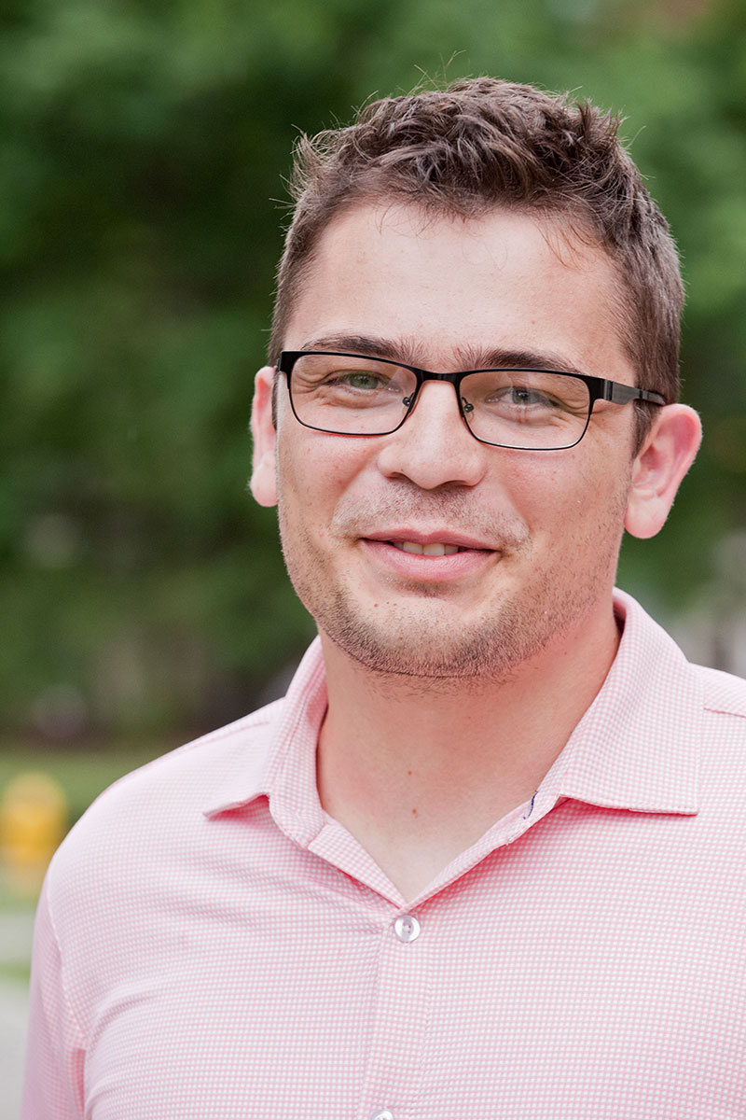
Javascript and jsPsych
Javascript: a programming language that runs in web browsers
jsPsych: a library that makes it easy to build experiments (https://www.jspsych.org)
de Leeuw, J. R. (2015). jsPsych: A JavaScript library for creating behavioral experiments in a web browser. Behavior Research Methods, 47, 1-12. doi:10.3758/s13428-014-0458-y.
Josh de Leeuw
Vassar College
Notes:
Vassar = liberal arts college in upstate NY (I think)

Slide 3
Resources for teaching yourself jsPsych
My course
2020 version: https://kennysmithed.github.io/oels2020/ (NB uses older version of jsPsych)
2021 version (ongoing!): https://kennysmithed.github.io/oels2021/
These tutorial materials: https://github.com/kennysmithed/evwall_talsmith
The main jsPsych webpage: https://www.jspsych.org
Josh de Leeuw’s tutorials at Moving Research Online workshop, 2020: https://www.movingresearchonline.info
jsPsych discussion forum on github: https://github.com/jspsych/jsPsych/discussions

Slide 4
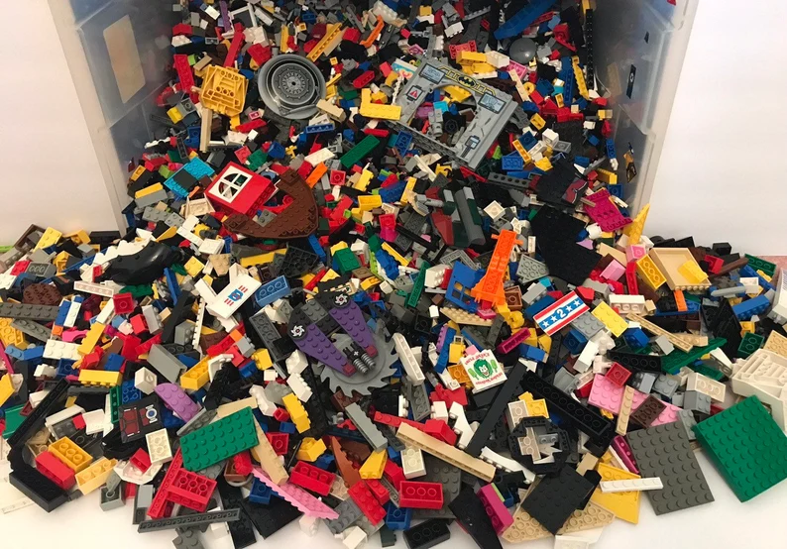
Notes:
Plugins and timelines

Slide 5
Plugins and timelines
Plugins: basic building blocks
Timeline: a sequence of those building blocks
Notes:
This is from the hello world example in the jsPsych starter tutorial

Slide 6
A wide range of plugins available
See https://www.jspsych.org/plugins/list-of-plugins/
Building an experiment involves
Knowing how to use plugins
Figuring out how to piece them together
Some tiny bits of html and javascript to connect the plugins and make them do what you want
(Occasionally, and optionally, making your own plugin)
Massive reuse of code within and across experiments!
Notes:
We will only use a few of them on this course

Slide 7
Common components of artificial language learning experiments
1. Consent and instructions
Minimally, some text + a button click
2. Training
Stimuli can be images, text, sounds
Entirely passive, or responses required to maintain engagement?
3. Test
Stimuli can be images, text, sounds
Responses required: button clicks, key presses, spoken responses
4. Demographics/additional info
Radio buttons, drop-down menus, numbers, free-text comments, …

Slide 8
A simple frequency-learning experiment
Ferdinand, V., Kirby, S., & Smith, K. (2019). The cognitive roots of regularization in language. Cognition, 184, 53-68.
(Code: https://kennysmithed.github.io/oels2020/oels_practical_wk6.html)
Under what conditions do participants accurately track frequency distributions in their input, and when do they regularize (over-use frequent variants)?
Standard paradigm in the artificial language learning literature, e.g. Hudson Kam & Newport, 2005; Vouloumanos, 2008; Reali & Griffiths, 2009; Smith & Wonnacott, 2010; Culbertson et al., 2012; …
We were interested in effects of domain (linguistic vs non-linguistic stimuli) and demand (number of frequency distributions you have to track)

Slide 9
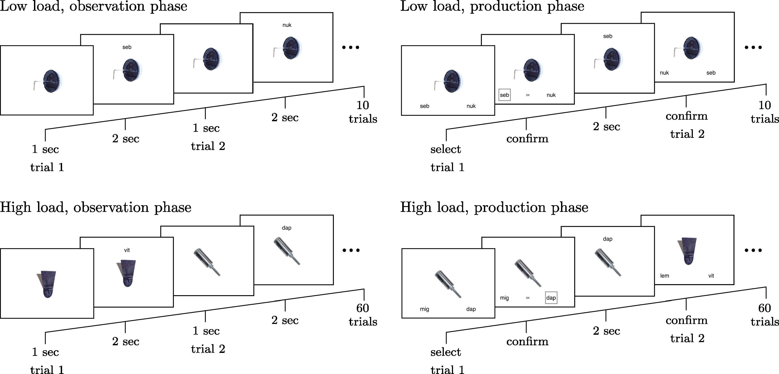
Notes:
I can see I have to present an image plus some text in observation trials. In production trials, I have to present an image plus two buttons. image-button-response plugin will allow me to do all of this.

Slide 10
Notes:
I can see I have to present an image plus some text in observation trials. In production trials, I have to present an image plus two buttons. image-button-response plugin will allow me to do all of this.

Slide 11
Using an image-button-response plugin to show image
Notes:
I can see I have to present an image plus some text in observation trials. In production trials, I have to present an image plus two buttons. image-button-response plugin will allow me to do all of this.

Slide 12
This specific image is called object2.png
Notes:
I can see I have to present an image plus some text in observation trials. In production trials, I have to present an image plus two buttons. image-button-response plugin will allow me to do all of this.

Slide 13
Show it for 1000ms
Notes:
I can see I have to present an image plus some text in observation trials. In production trials, I have to present an image plus two buttons. image-button-response plugin will allow me to do all of this.

Slide 14
No response required!
Notes:
I can see I have to present an image plus some text in observation trials. In production trials, I have to present an image plus two buttons. image-button-response plugin will allow me to do all of this.

Slide 15
Using an image-button-response plugin to show image
Notes:
I can see I have to present an image plus some text in observation trials. In production trials, I have to present an image plus two buttons. image-button-response plugin will allow me to do all of this.

Slide 16
This specific image is called object2.png
Notes:
I can see I have to present an image plus some text in observation trials. In production trials, I have to present an image plus two buttons. image-button-response plugin will allow me to do all of this.

Slide 17
Show it along with label using the prompt parameter
Notes:
I can see I have to present an image plus some text in observation trials. In production trials, I have to present an image plus two buttons. image-button-response plugin will allow me to do all of this.

Slide 18
Show it for 2000ms
Notes:
I can see I have to present an image plus some text in observation trials. In production trials, I have to present an image plus two buttons. image-button-response plugin will allow me to do all of this.

Slide 19
No response required!
Notes:
I can see I have to present an image plus some text in observation trials. In production trials, I have to present an image plus two buttons. image-button-response plugin will allow me to do all of this.

Slide 20
Show (different) image
Notes:
I can see I have to present an image plus some text in observation trials. In production trials, I have to present an image plus two buttons. image-button-response plugin will allow me to do all of this.

Slide 21
Show (different) image + label
Notes:
I can see I have to present an image plus some text in observation trials. In production trials, I have to present an image plus two buttons. image-button-response plugin will allow me to do all of this.

Slide 22
String many trials together to form a timeline
Notes:
I can see I have to present an image plus some text in observation trials. In production trials, I have to present an image plus two buttons. image-button-response plugin will allow me to do all of this.

Slide 23
Notes:
OK, so this is going to be the same idea, and I can already see that I can re-use something – the post-confirmation display phase is exactly like the labelling trials during training, so I can re-use code there. But now I will be adding in choices. And a tricky thing – what I show during the post-confirmation display will depend on what they clicked on - *contingent trials*, very typical in experiments involving any kind of feedback.

Slide 24
Using an image-button-response plugin to show image and get response
Notes:
OK, so this is going to be the same idea, and I can already see that I can re-use something – the post-confirmation display phase is exactly like the labelling trials during training, so I can re-use code there. But now I will be adding in choices. And a tricky thing – what I show during the post-confirmation display will depend on what they clicked on - *contingent trials*, very typical in experiments involving any kind of feedback.

Slide 25
choices parameter contains labels for buttons
Notes:
OK, so this is going to be the same idea, and I can already see that I can re-use something – the post-confirmation display phase is exactly like the labelling trials during training, so I can re-use code there. But now I will be adding in choices. And a tricky thing – what I show during the post-confirmation display will depend on what they clicked on - *contingent trials*, very typical in experiments involving any kind of feedback.

Slide 26
Note we no longer specify the trial duration: trial lasts until the participant responds
Notes:
OK, so this is going to be the same idea, and I can already see that I can re-use something – the post-confirmation display phase is exactly like the labelling trials during training, so I can re-use code there. But now I will be adding in choices. And a tricky thing – what I show during the post-confirmation display will depend on what they clicked on - *contingent trials*, very typical in experiments involving any kind of feedback.

Slide 27
Confirm trial: going to do this slightly differently and make them click on a button showing the label they just selected
Notes:
OK, so this is going to be the same idea, and I can already see that I can re-use something – the post-confirmation display phase is exactly like the labelling trials during training, so I can re-use code there. But now I will be adding in choices. And a tricky thing – what I show during the post-confirmation display will depend on what they clicked on - *contingent trials*, very typical in experiments involving any kind of feedback.

Slide 28
dap
Confirm trial: going to do this slightly differently and make them click on a button showing the label they just selected
Notes:
OK, so this is going to be the same idea, and I can already see that I can re-use something – the post-confirmation display phase is exactly like the labelling trials during training, so I can re-use code there. But now I will be adding in choices. And a tricky thing – what I show during the post-confirmation display will depend on what they clicked on - *contingent trials*, very typical in experiments involving any kind of feedback.

Slide 29
dap
When we build the timeline (i.e. when the experiment is loaded), we don’t know what the confirmation label will be!
Notes:
OK, so this is going to be the same idea, and I can already see that I can re-use something – the post-confirmation display phase is exactly like the labelling trials during training, so I can re-use code there. But now I will be adding in choices. And a tricky thing – what I show during the post-confirmation display will depend on what they clicked on - *contingent trials*, very typical in experiments involving any kind of feedback.

Slide 30
dap
But by the time this trial starts, we can retrieve it…
Notes:
OK, so this is going to be the same idea, and I can already see that I can re-use something – the post-confirmation display phase is exactly like the labelling trials during training, so I can re-use code there. But now I will be adding in choices. And a tricky thing – what I show during the post-confirmation display will depend on what they clicked on - *contingent trials*, very typical in experiments involving any kind of feedback.

Slide 31
dap
…by consulting the data generated by the immediately preceding trial
Notes:
OK, so this is going to be the same idea, and I can already see that I can re-use something – the post-confirmation display phase is exactly like the labelling trials during training, so I can re-use code there. But now I will be adding in choices. And a tricky thing – what I show during the post-confirmation display will depend on what they clicked on - *contingent trials*, very typical in experiments involving any kind of feedback.

Slide 32
dap
That will be the label for our confirmation button
Notes:
OK, so this is going to be the same idea, and I can already see that I can re-use something – the post-confirmation display phase is exactly like the labelling trials during training, so I can re-use code there. But now I will be adding in choices. And a tricky thing – what I show during the post-confirmation display will depend on what they clicked on - *contingent trials*, very typical in experiments involving any kind of feedback.

Slide 33
dap
Post-confirmation display looks like a training trial…
Notes:
OK, so this is going to be the same idea, and I can already see that I can re-use something – the post-confirmation display phase is exactly like the labelling trials during training, so I can re-use code there. But now I will be adding in choices. And a tricky thing – what I show during the post-confirmation display will depend on what they clicked on - *contingent trials*, very typical in experiments involving any kind of feedback.

Slide 34
dap
…except we use the same trick to get the prompt from their previous trial response
Notes:
OK, so this is going to be the same idea, and I can already see that I can re-use something – the post-confirmation display phase is exactly like the labelling trials during training, so I can re-use code there. But now I will be adding in choices. And a tricky thing – what I show during the post-confirmation display will depend on what they clicked on - *contingent trials*, very typical in experiments involving any kind of feedback.

Slide 36
Using an html-button-response plugin to show formatted text and get them to click
Notes:
*definitely* going to need a consent screen

Slide 37
The “stimulus” is the text that will appear on the screen.
(I have added some formatting to make it look nice)
Notes:
*definitely* going to need a consent screen

Slide 38
Here there is only one choice, which is to consent
Notes:
*definitely* going to need a consent screen

Slide 40
survey-html-form allows you to collect various kinds
of responses on a single screen

Slide 41
Demo

Slide 42
An example involving audio stimuli and keyboard responses
Based on Gomez, R. L. & Gerken, L. (1999) Artificial grammar learning by 1-year-olds leads to specific and abstract knowledge. Cognition, 70, 109-135.
Can participants implicitly learn an underlying grammar from presentation of positive examples, and subsequently differentiate between strings generated by / not generated by that grammar?
Standard paradigm in the artificial grammar learning literature, e.g. Reber, 1967, 1989; Wilson et al., 2015; …
audio-keyboard-response plugin to present word sequences during training (NB no response required)
html-keyboard-response plugin to obtain yes/no responses on test trials

Slide 43
Demo

Slide 44
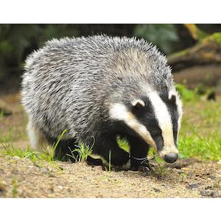


An unexpected challenge: multimodal stimuli
Previous examples were quite easy to achieve using existing plugins
But what if there isn’t a plugin that does exactly what you want? E.g. image and audio on a single trial
Two options:
Smuggle in images to the prompt on an audio-button-response trial, or smuggle in audio to the prompt on an image-button response trial
Edit the plugin to produce a custom plugin, e.g. an image-audio-button-response plugin!
Click to listen
Notes:
Not as hard as it sounds – and you can also use this to make superficial changes, add extra text fields, make a 2-image plugin, etc

Slide 45
An unexpected challenge: multimodal stimuli
Click to listen
Notes:
Not as hard as it sounds – and you can also use this to make superficial changes, add extra text fields, make a 2-image plugin, etc

Slide 46
Demo

Slide 47
Additional things you will want to know how to do
Random assignment to conditions
Preloading stimuli
Saving data
Recording audio responses
Reading in trial lists
Contingent progression

Slide 48
Random assignment to conditions

Slide 49
Demo

Slide 50
Preloading stimuli
Downloading images, sound files etc takes an unpredictable amount of time.
Trial durations ignore the time taken to download
And beware: if you are testing your code, your browser might already have loaded and cached the stimuli, so you won’t notice the lag
The solution: preloading
Requires you to use the preload plugin
Certain plugins mark parameters (e.g. stimuli) for automatic preloading by the preload plugin
You can add everything else to a manual preload list
See jsPsych pages on preloading: https://www.jspsych.org/overview/media-preloading/

Slide 51
Saving data
You need to save data on your server, not on the participant’s computer!
Requires a bit of extra infrastructure: PHP script to write data to server (and a server that can run PHP)
See e.g.
jsPsych pages on data: https://www.jspsych.org/overview/data/
Week 6+ of my course (e.g. https://kennysmithed.github.io/oels2020/oels_practical_wk6.html)
You can save data at the end of the experiment or after every trial
Do trial-by-trial if you can!

Slide 52
Recording audio responses
Accessing a participants’ microphone (and camera!) is quite straightforward
Although they have to approve, so you need to warn them you will request access
Recording audio data involves a little bit of extra work
Another PHP script to save the audio data to your server
See week 8 of my course: (https://kennysmithed.github.io/oels2020/oels_practical_wk8.html)
Audio quality varies, and sometimes the quality degrades, but you get decent audio from 95% of participants

Slide 53
Reading in trial lists
I usually generate trial lists on the fly in the experiment code
e.g. using a jsPsych.randomization.repeat, or a for-loop
If you prefer to have the trial list in a separate file on the server, that’s possible too
Reading in CSV files is slightly tricky because it involves a delay in accessing a file on the server (you have to force the browser to wait until the trial list is loaded)
See weeks 8-10 of my course (https://kennysmithed.github.io/oels2020/oels_practical_wk8.html)

Slide 54
Contingent progression
Useful to be able to control who progresses beyond a certain point in your experiment
See https://www.jspsych.org/overview/timeline/#conditional-timelines
(Martin & White, 2021, p. 229-230)
Notes:
Show them the conditionals example

Slide 55
Demo

Slide 56
Other platforms are available!
Flexible
Inflexible
Qualtrics
Gorilla
Psychopy3
Raw
javascript
jsPsych
Difficult
Easy

Slide 57
Time for questions?

